Slide 2
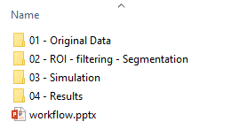

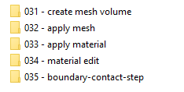

Data aquisition: uncompress data, reorganize it check for problems
Volume mask creating: create the masks for representing the volumes to mesh. Remove un-wanted elements from the scans, repair geometry
Create inp file with material properties: Using the mask, create a 3D volume using triangulation. Map each element’s property to the grey level in the CT.
Image pre-processing: Change data type, select ROI, mise à l’échelle des niveaux de gris
Edit model for impact simulation: open the inp file in abaqus and then run python scripts to set up the simulation.

Slide 3

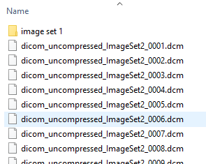
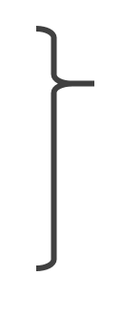
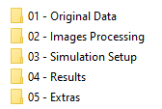

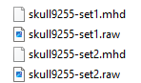
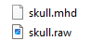
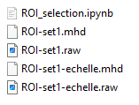
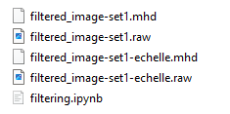
Python
Uncompress Dicom files: And reoganize them according to their serie-description
.
.
.
.
.
.
Python
021 – Saving as MHD: convert all these dicom file into one pair of RAW and DHM file. Note that there are two set bcse each skull was scanned using 2 sets of parameters. For the rest of this workflow, we will only present one set
Starting from step 022, each manipulation done on an image is specific to every skull. Thus, to ensure reproducibility, scripts used to do these manipulation are saved at each step, with their values.
022 – ROI selection: crop the volume into a ROI. Save the cropped region into another pair of RAW and DHM file. Do the same with the mineralization scale.
023 – filtering: apply desired image filters onto the cropped region. Save the filtered images into another pair of RAW and DHM file. Do the same with the mineralization scale.

Slide 4
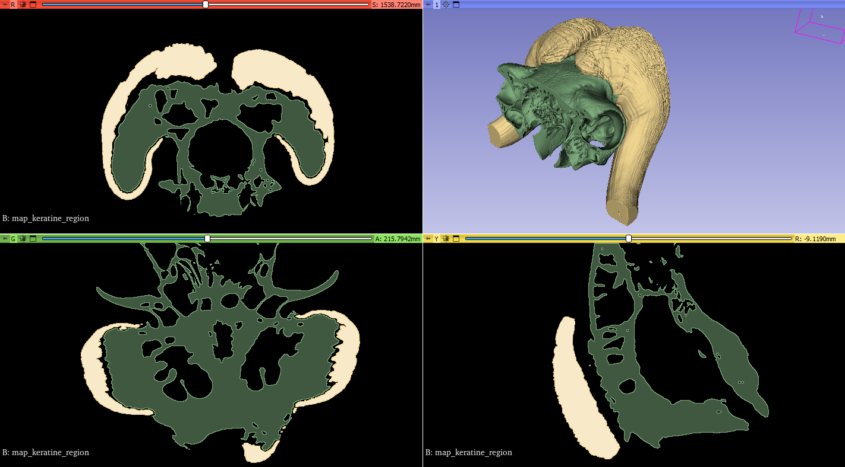
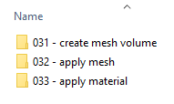

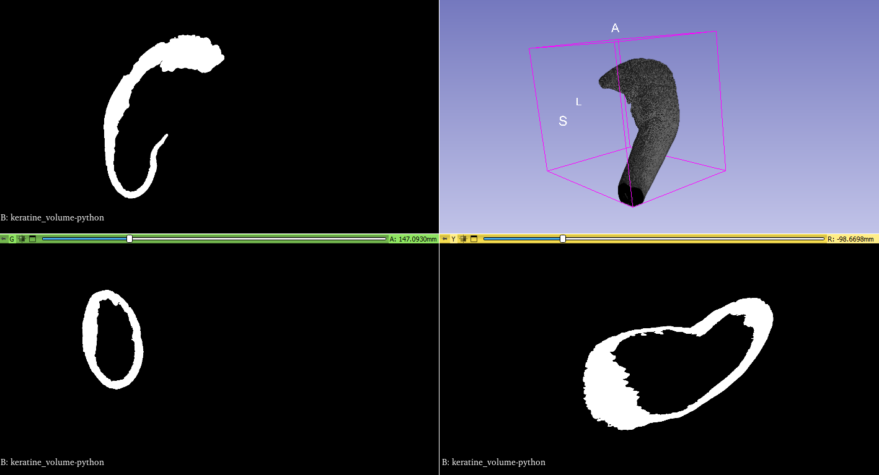

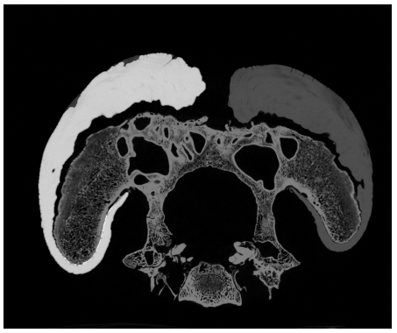
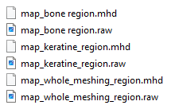
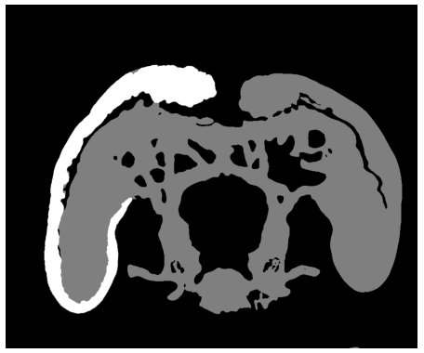
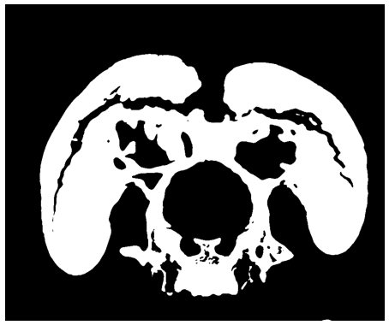
Python
Map keratine region: Use python to create a black and white map of the keratine in the horns that needs to be meshed.
Map whole meshing region: Use python to create a black and white map of the whole region of the skull that needs to be mesh (bone + keratine)
Python
Map bone region: substract the keratine map the the whole mesh map the get the map of only the bones!

Slide 5
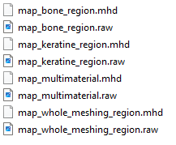
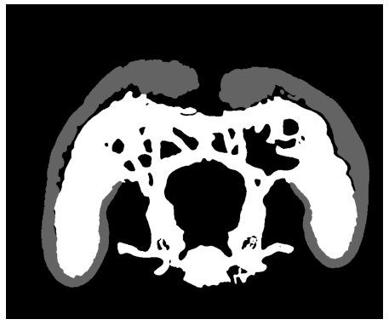
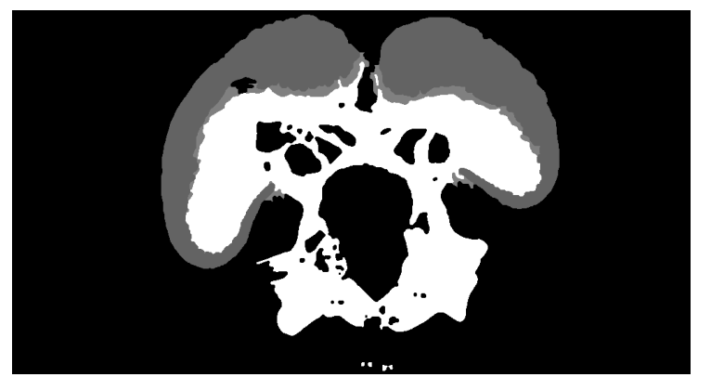

Python
Map multimaterial : add the keratine map and the bone map into a 2-levels map
Python
Fill crack: Fill the crack in between the keratine and the bone with keratine

Slide 6
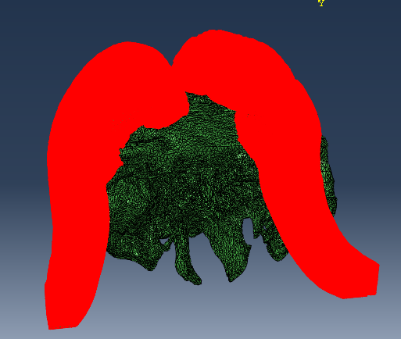
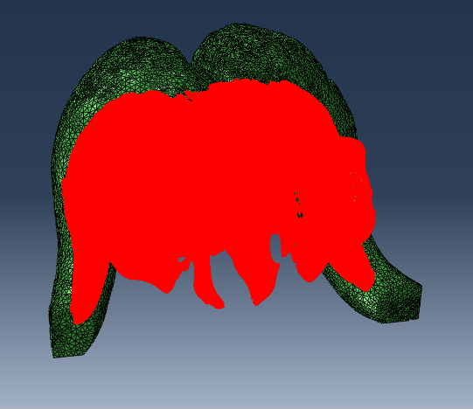
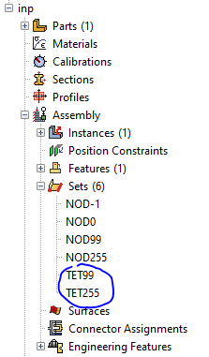
Medtool
032 – apply mesh: using the map, a 3D TET mesh is created. It respects the borders of the different levels of the map. It is saved as an inp file, with all the levels saved in different sets
Note the name of the two sets. They are call «TET» because made of tet elements, followed by a number corresponding to the grey level of the input map!

Slide 7
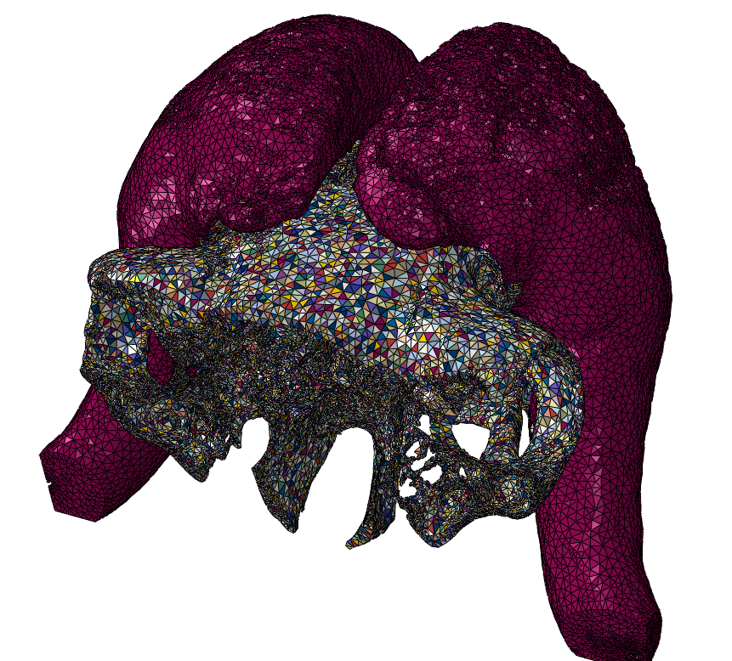
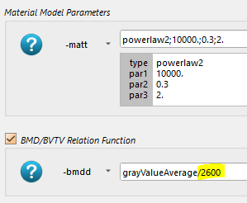
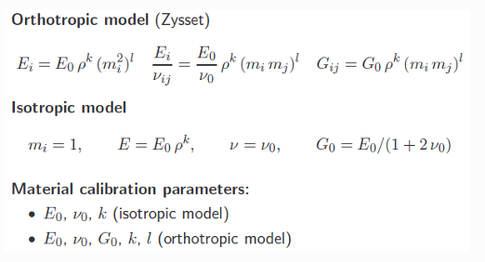
Medtool
033 – apply material: The filtered images are used as reference. Maps material properties to each element according to density.

